Slide 1
Learning Semantic Relationships of Geographical Areas Based on Trajectories
Presenter: Saim Mehmood

Slide 2
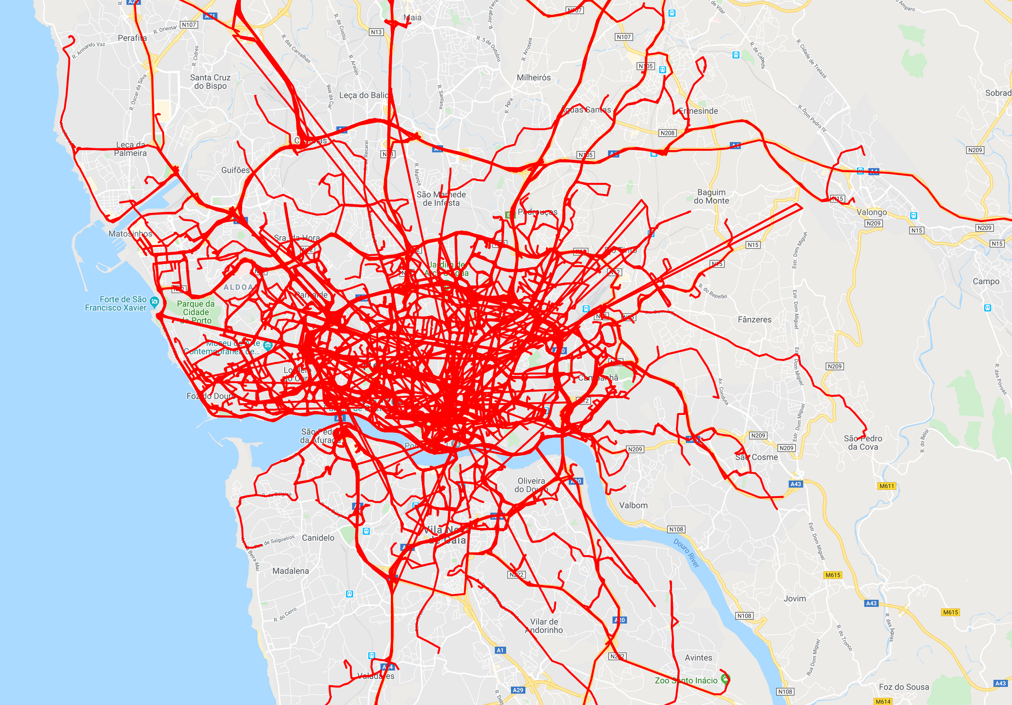
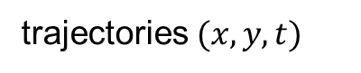
trajectories $(x,y,t)$
(spatiotemporal information of moving objects)
Notes:
So now the question is, how can we use these trajectories?

Slide 3
Trajectory Data Mining

Slide 4
discovering patterns in trajectories to inform critical real-world applications
Notes:
Purpose of trajectory data mining is to…

Slide 5
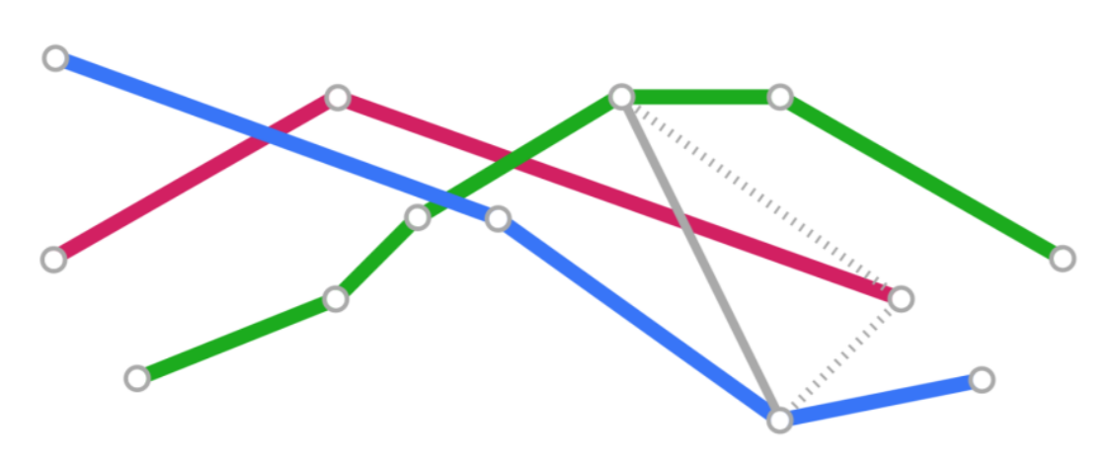
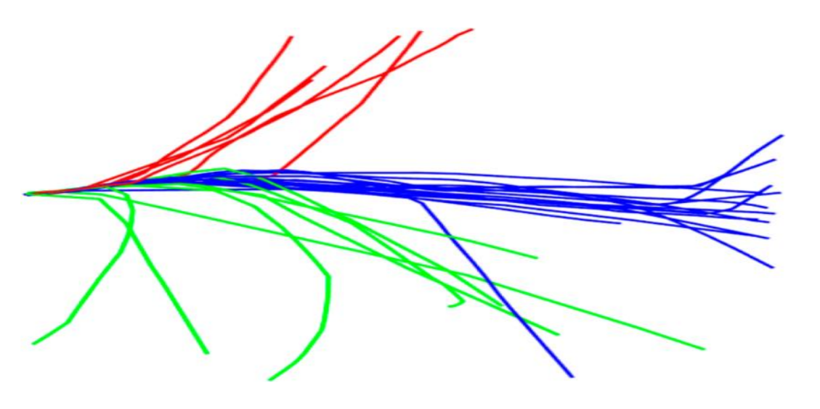
Trajectory Data Mining Tasks
trajectory similarity
trajectory clustering
trajectory anomaly detection
trajectory classification
trajectory prediction
etc…

Slide 6

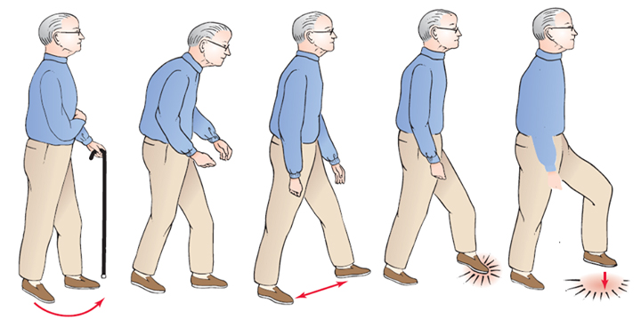
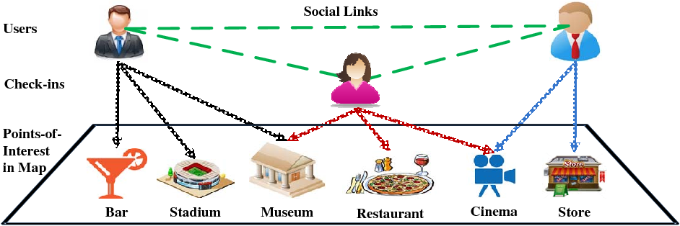
Trajectory Applications
human mobility understanding
healthcare (detecting change in gait pattern of seniors)
location-based services (e.g., recommendation of points-of-interest)

Slide 7
Research Questions

Slide 8
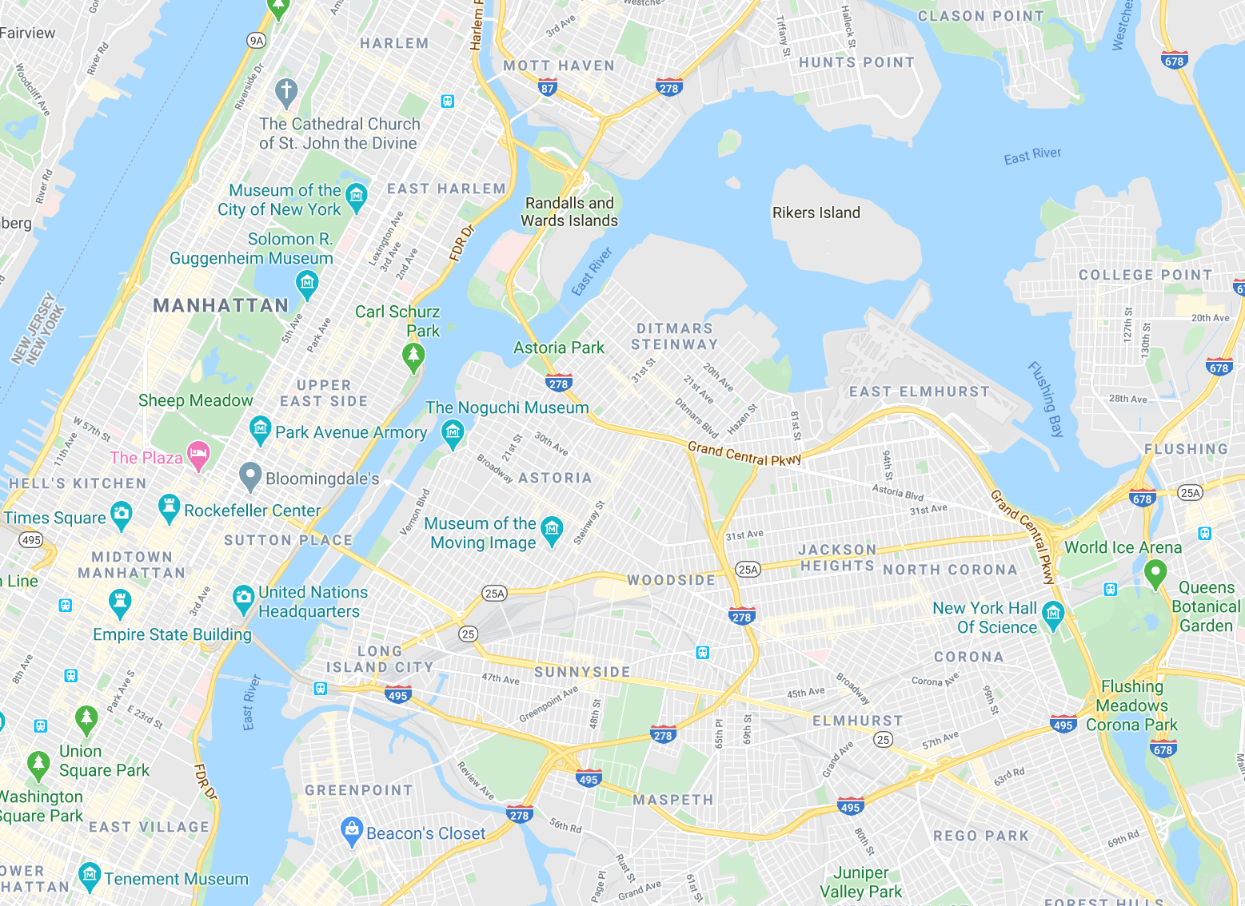
Research Question I
How people perceive different areas of their city?
Notes:
Is something more related than something else? Yes or No. (Qualitative)

Slide 9
Research Question II
To what extent people rely on geographical proximity of areas?
Notes:
What is the effect of proximity? How much? (Quantitative)

Slide 10
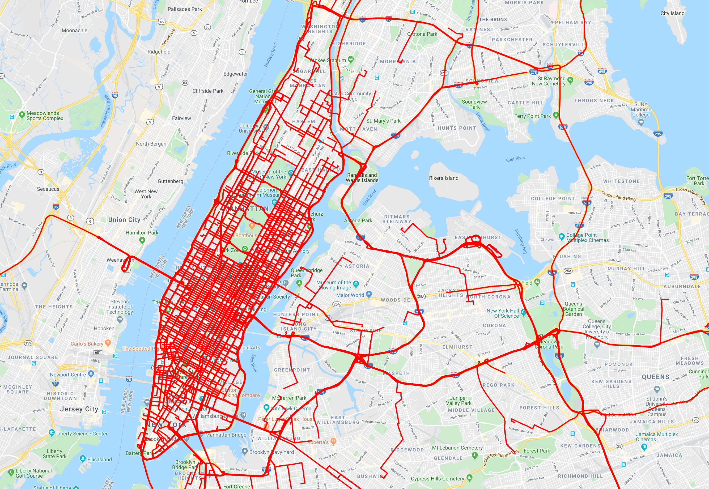
Research Question III
City I
City II
How the behavior of people compare in different geographical space?
Notes:
So now; let us move to my approach towards answering these research questions.

Slide 11
Overview
Method 1
Learning Semantic Relationships of Geographical Areas
Method 2
Statistical Method for Distinguishing Geographical Proximity to Semantic Proximity

Slide 12
Learning Semantic Relationships of Geographical Areas
Notes:
- Method that gives me semantics of a neighborhood.
- Relation between geographical areas based on trajectories

Slide 13
How can we learn latent semantic relationships between geographical areas using trajectories?
Notes:
- Before we go further, let’s discuss some key concepts

Slide 14
Geographical Proximity
Semantic Proximity
Notes:
Spend more time here!
Geographical: nodes are close to each other in physical space
Semantic: nodes are close to each other based on multiple trajectories passing through both of them.
Next slide discusses that.

Slide 15
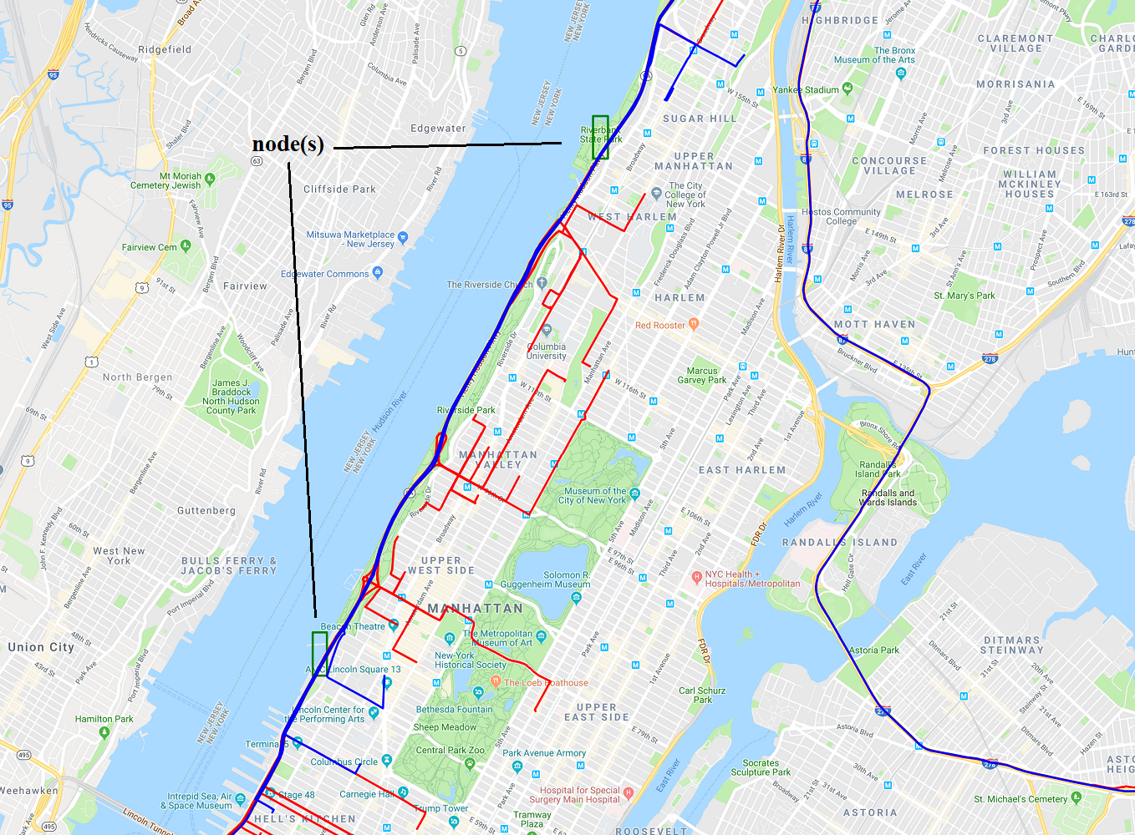
Notes:
Two grid cells (green rectangles) with several trajectories traversing both of them (shown as blue
line), compared to trajectories that traverse either of them (shown as red line).

Slide 16
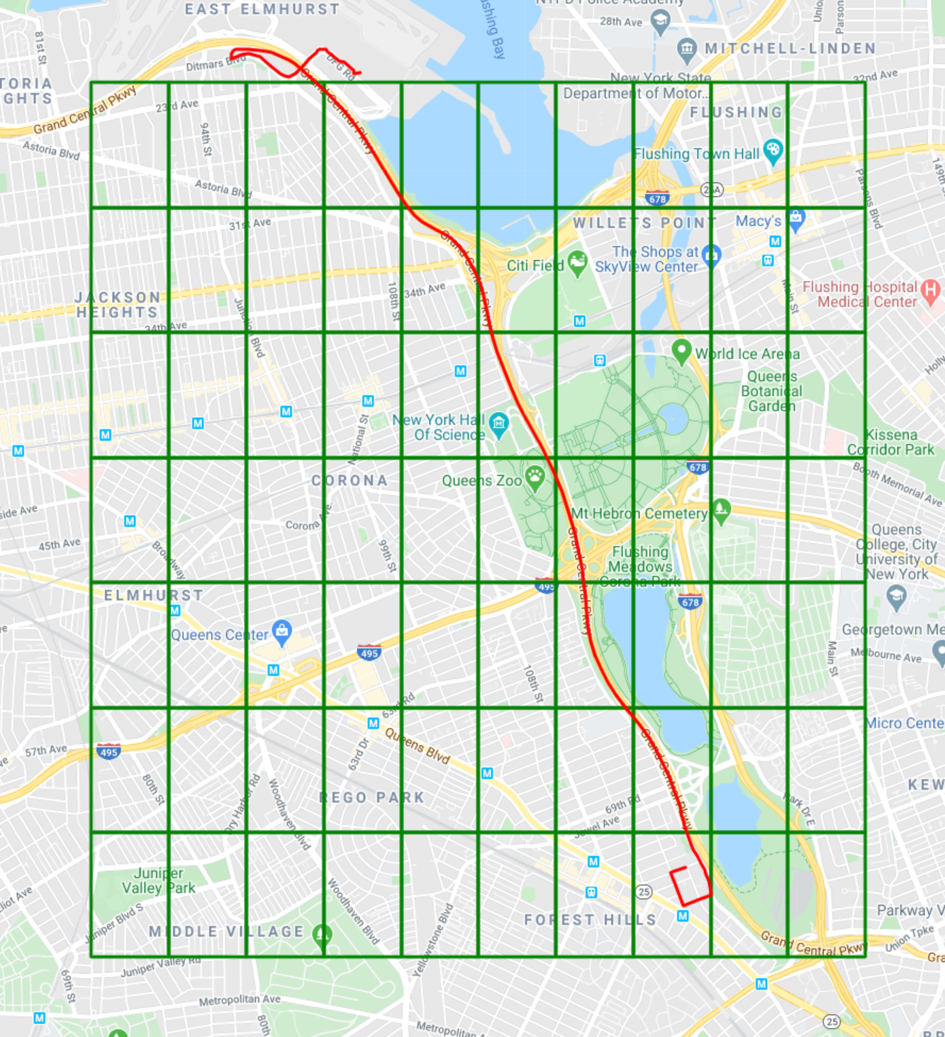
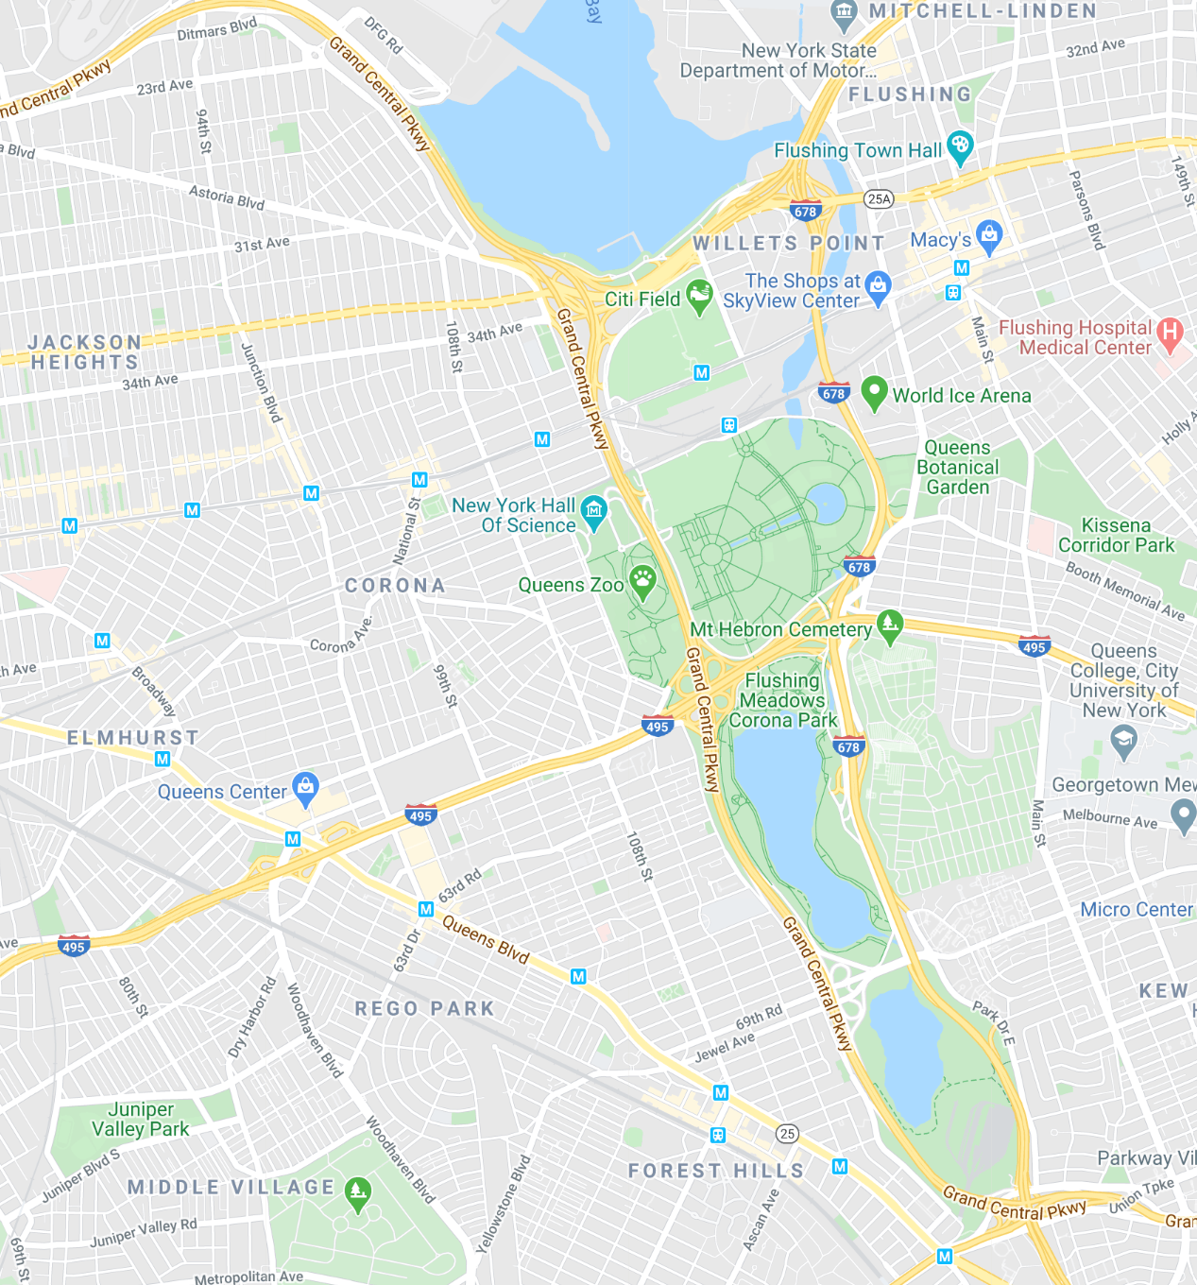
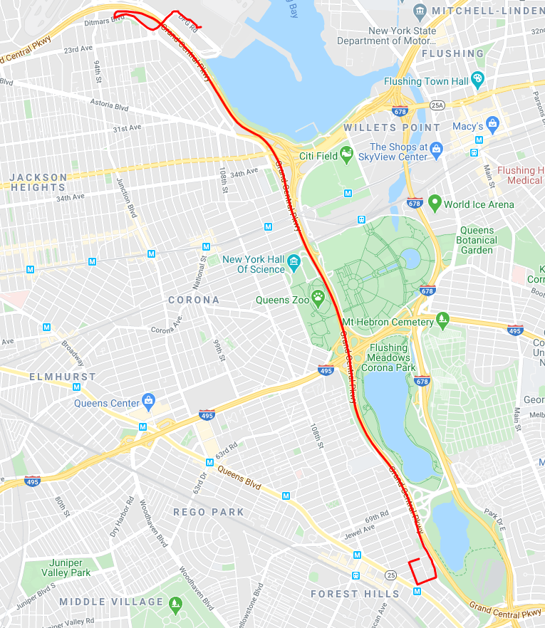
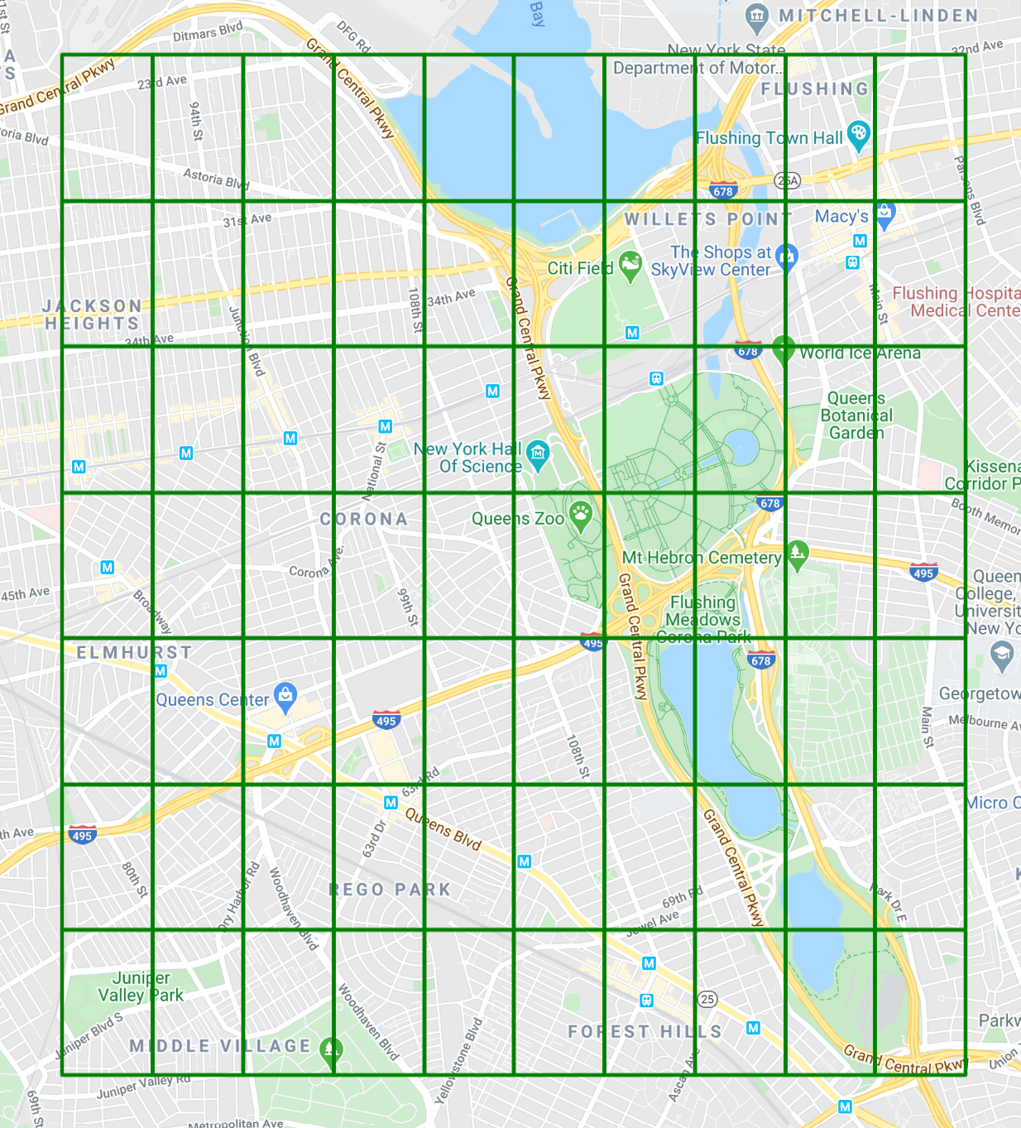
Construction of a Uniform Grid
0
1
2
3
4
5
6
7
8
9
0
1
2
3
4
5
6
7
8
9
0
0
1
1
2
2
3
3
4
4
5
5
6
6
Notes:
Why a grid? Instead of doing direct analysis on trajectories, grid cells make it computationally efficient to relate geographical areas using trajectories.

Slide 17
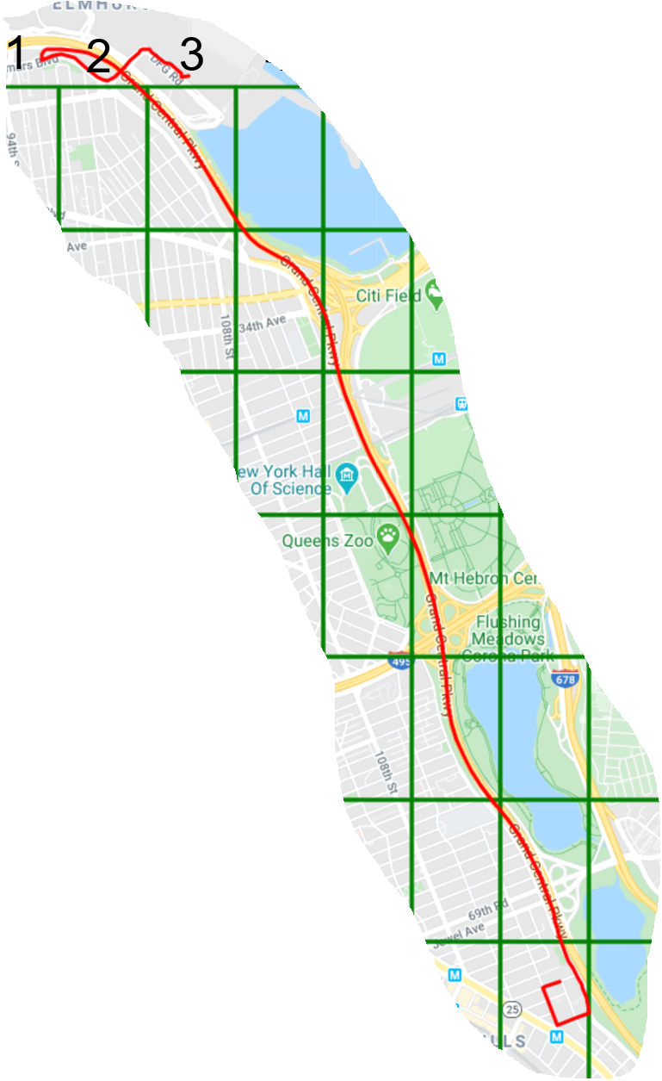
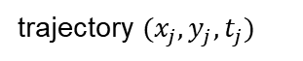


How I Convert Trajectory Into Grid Cells?
trajectory $(x_{i},y_{i},t_{i})$
trajectory $(x_{j},y_{j},t_{j})$
trajectory $(x_{k},y_{k},t_{k})$
Notes:
By dividing A into grid cells we can translate trajectory from a sequence of geolocations to a sequence of grid cells.
We convert trajectory into grid cells by performing spatial queries using postgresql and postgis.

Slide 18
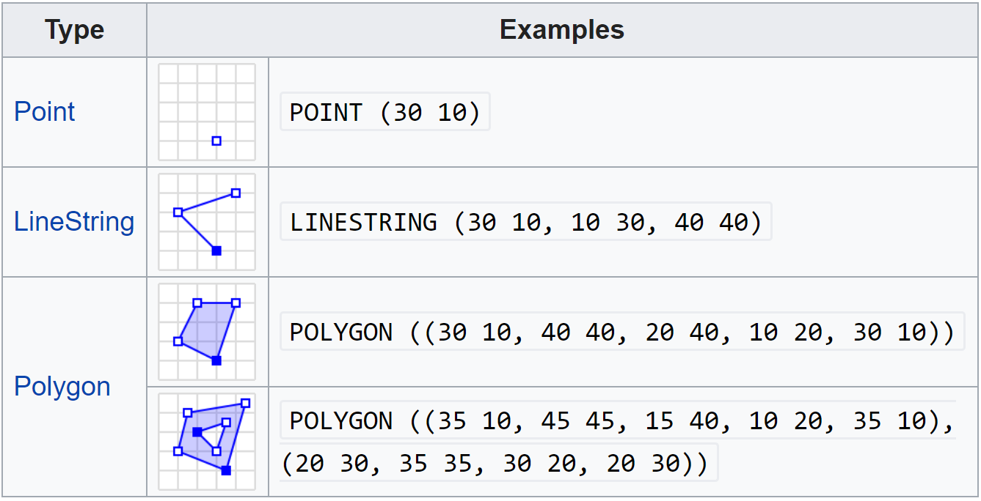
PostGIS: object data types
Notes:
Different object types of postgis: each traj is stored as linestring and grid as polygon.
- It runs efficient queries that are spatial, giving us association of traj with grid cells

Slide 19
How can I find relationships of geographical areas?
learn relationships using
network representation learning (NRL)

Slide 20
Network Representation Learning (NRL)

Slide 21
Network Representation Learning (NRL)
Network/Graph
Low-dimension space
several network structural properties can be learned/embedded
(nodes, edges, subgraphs, graphs, …)
Notes:
- embed network vertices into a low-dimensional vector space, by preserving network topology structure, vertex content etc.
There is another version of NRL.

Slide 22
Random Walk-based NRL
3
5
3
5
8
8
3 5 8 7 6 4 5
4
6
4
6
1
1
1
1
9
9
2
7
2
7
1 | 3 5 8 7 6 4 5
2 | 1 3 5 8 7 6 5
. . . . | . . . .
87 | 8 5 4 3 5 6 7
88 | 4 5 6 7 8 9
89 | 2 1 3 5 6 7 8
90 | 7 4 2 1 3 5 6
Input graph
Obtain a set of
random walks
2
1
4
3
5
8
6
Treat the set of random walks as sentences
9
7
vector embedding
for each node
Feed sentences to
Skip-gram NN model

Slide 23
NRL in our Approach

Slide 24
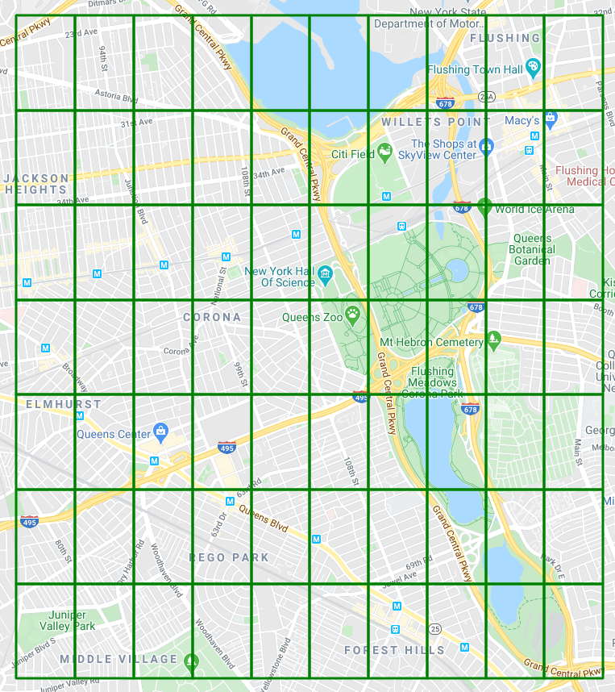
Construction of a lattice graph
0
1
edge
0
0
edge
Grid Cells
1
0
lattice graph
Notes:
Put different grid sizes.

Slide 25
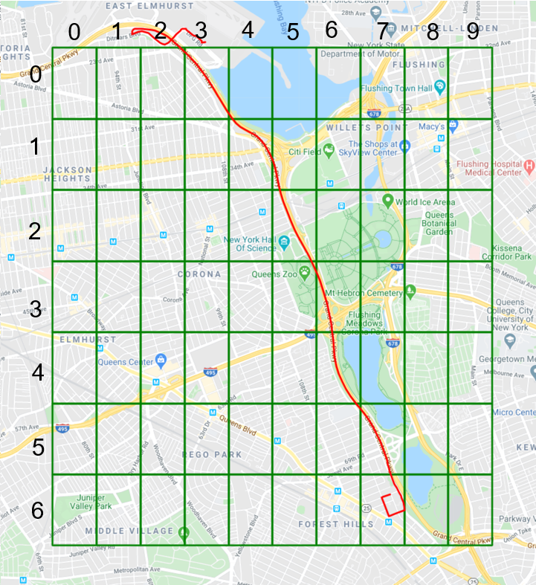
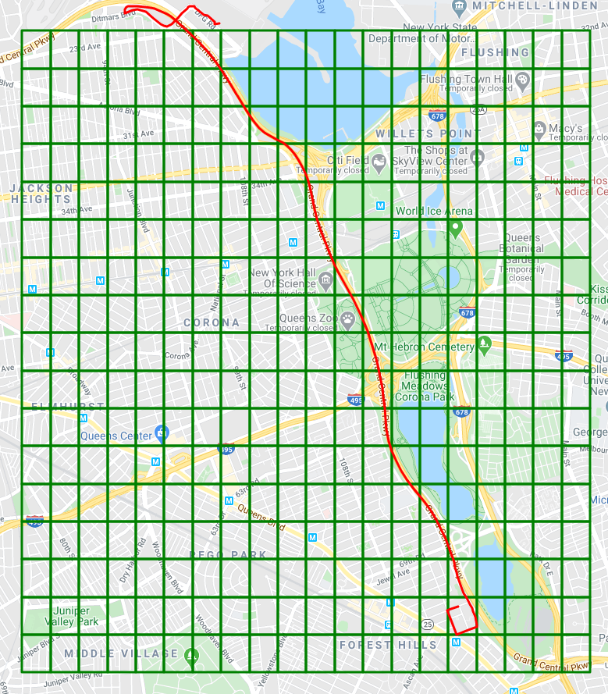
Trade-off by increasing grid numbers

Slide 26
Trajectory as walks
lattice graph

Slide 27
Trajectory Permutations: skip-gram limitation
nodes appearing in same context window are more similar
for trajectories, every node should be in the context of every other node
Skip-gram (context window)
shuffling
m-walks
m-times
single walk
feed walks to skip-gram NN model
Notes:
- By design skip-gram architecture weighs nearby context nodes more heavily than distant nodes.
- Shuffling will neutralize the effect of context nodes and distant nodes will not be less weighted than nearby nodes.

Slide 28
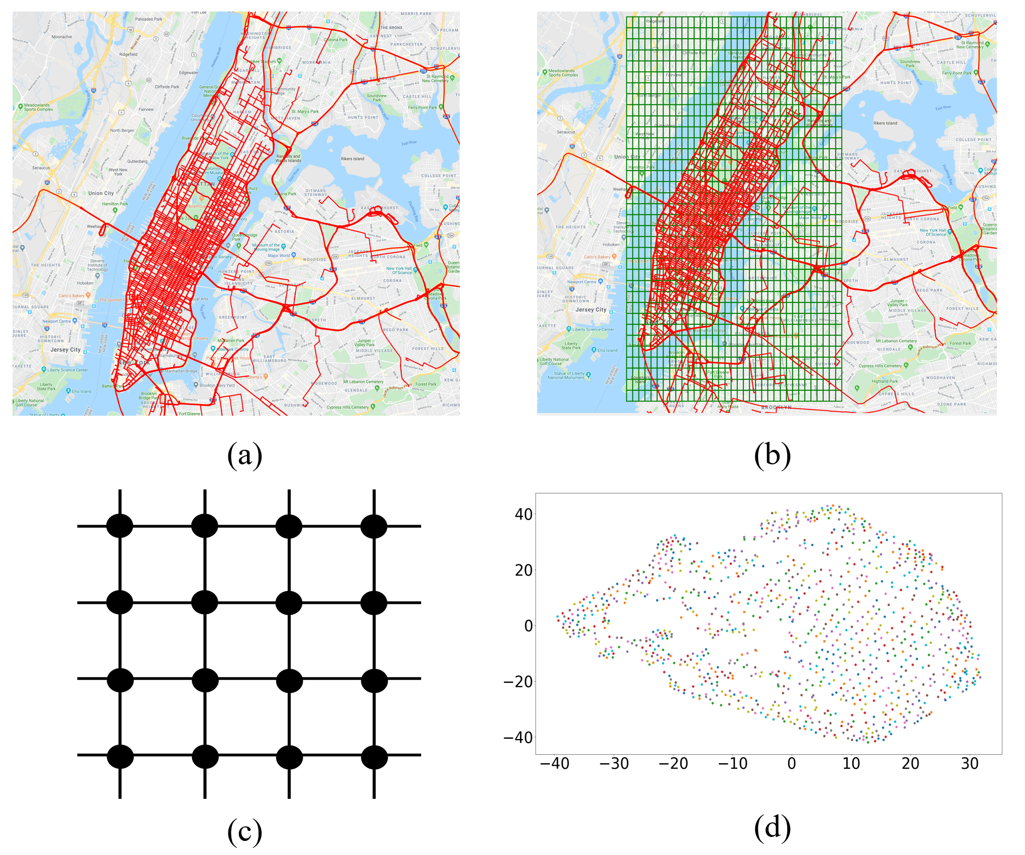
Method 1 Overview
Skip-gram
Notes:
Sample trajectories of NYC (b) trajectories traversing grid cells of a uniform grid
(c) lattice network of grid cells (d) node embeddings of trajectory walks.

Slide 29
Statistical Method for Distinguishing Geographical Proximity to Semantic Proximity
Notes:
Up till now, we discussed how to learn semantic relationships between geographical areas.
This section discuss statistical models including a null model based on null hypothesis (i.e., people perceive a city based on geographical proximity) which means chance to move from one place to another is dictated by physical separation (we will disprove this null hypothesis)

Slide 30
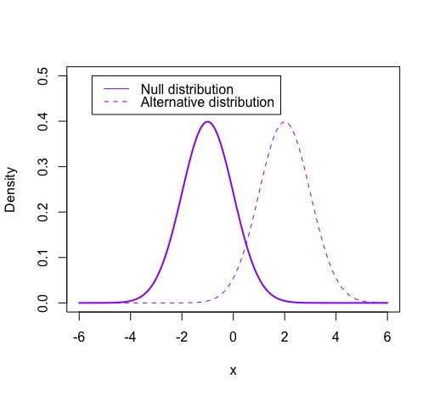
Real vs Null Hypothesis
Notes:
In our case null hypothesis will be: people move in geographical space based on geographical proximity.
Alternate distribution: people move based on specific set of patterns i.e., semantic proximity.
The null hypothesis tries to show that among two sets of data, there is no statistical difference between the results of doing one thing as opposed to doing a different thing.

Slide 31
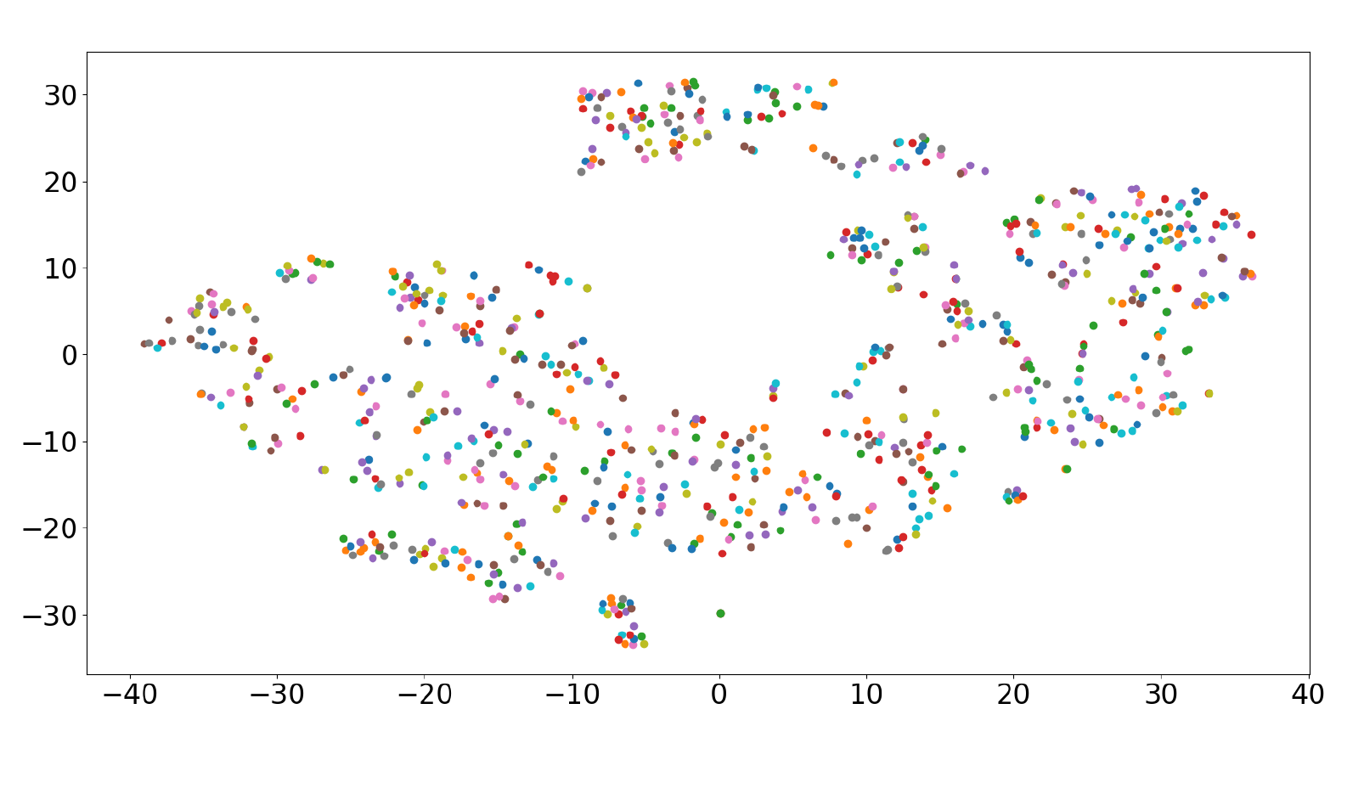
Real Model
Real model is based on real trajectory movements over lattice graph
method 1

Slide 32
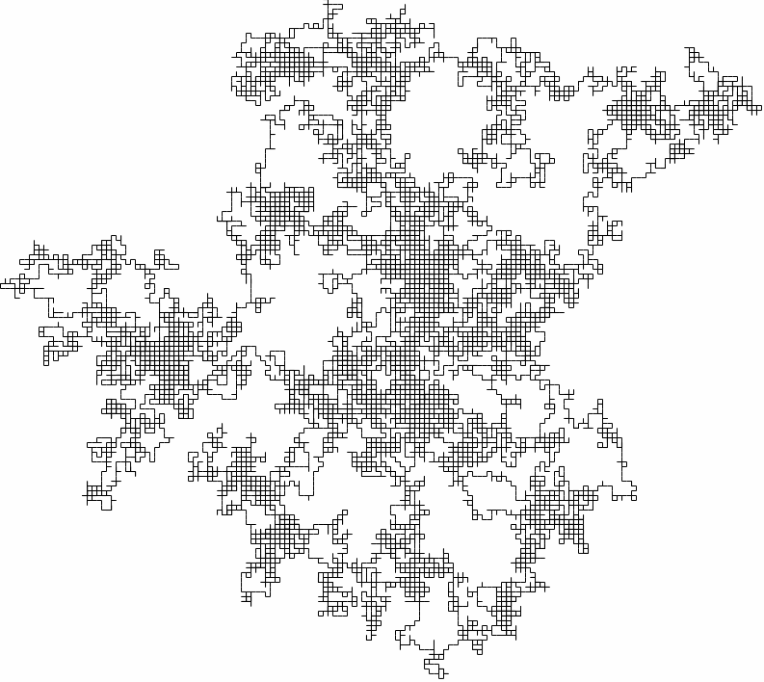
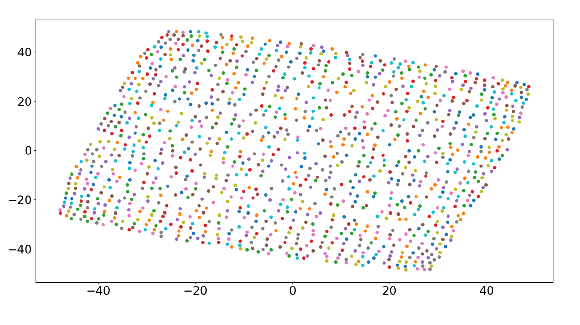
Null Model
Null Model is based on random walks but satisfies the size constraint
method 1
Notes:
- Same number of random trajectories as before. (we get trajectories by performing random walks)
- Size of each random walk is equal to the average of all real trajectories

Slide 33
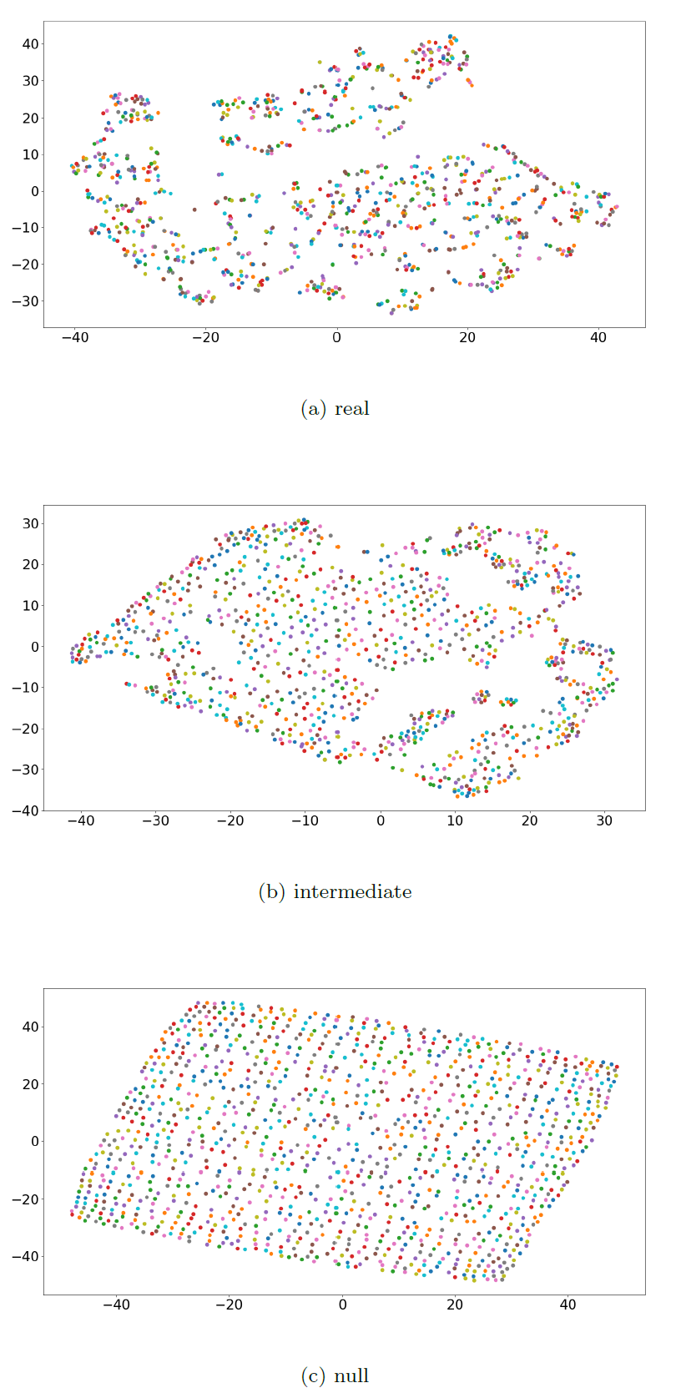
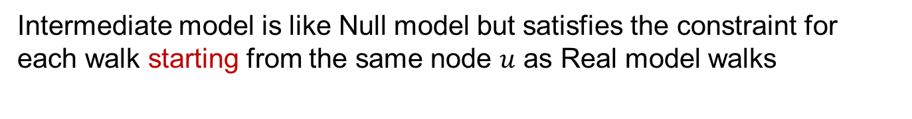
Alternate Null (Intermediate) Model
Intermediate model is like Null model but satisfies the constraint for each walk starting from the same node $u$ as Real model walks
method 1
Notes:
main motivation for this model is to learn vectors that can capture more of the constraints of the real trajectories, but still maintain the unbiased random walks on the lattice graph that are still dictated by geographic proximity

Slide 34
Model Comparative Analysis
how can we compare the
real vs the null model?
metrics for both quantitative and visual comparison
Notes:
Quantitative: Cosine similarity and difference, distribution of pair-wise similarity (histogram)
Visual: embeddings and heat maps
- The aforementioned models learn a low-dimensional vector representation for each graph node
- Further I discuss metrics that allow to compare models quantitatively and visually

Slide 35
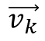
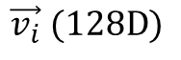
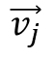
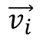
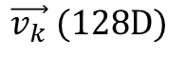
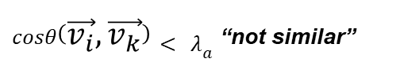
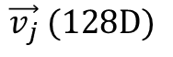
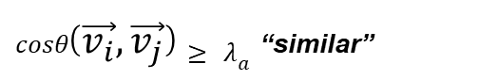
Quantitative: Cosine Similarity
$$\vec{v_{i}} (128D)$$
$$\vec{v_{j}} (128D)$$
$$\vec{v_{k}} (128D)$$
$$\vec{v_{k}}$$
$$\vec{v_{i}}$$
$$\vec{v_{j}}$$
$cosθ\left(\vec{v_{i}},\vec{v_{j}}\right)≥ λ_{a}$ _{“similar”}
$cosθ\left(\vec{v_{i}},\vec{v_{k}}\right)< λ_{a}$ _{“not similar”}
Notes:
Cosine similarity between vectors(nodes) is used to figure out pairs of nodes that are semantically similar

Slide 36
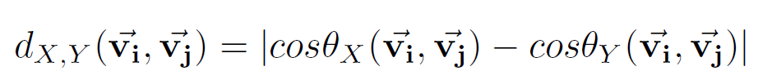
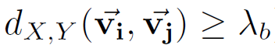
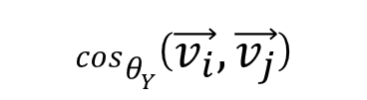
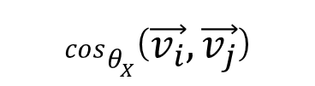
Quantitative: Interesting Pairs of Nodes
Let’s say we have two models $(X and Y)$
$$cosθ_{X}\left(\vec{v_{i}},\vec{v_{j}}\right)$$
$$cosθ_{Y}\left(\vec{v_{i}},\vec{v_{j}}\right)$$
_{“interesting”}
Notes:
Difference between cosine similarities of different models is used to find the most interesting pairs of nodes.
- pair of nodes are interesting when their associated vectors are found to be very similar in one model and dissimilar in the other.

Slide 37
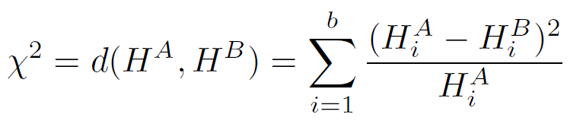
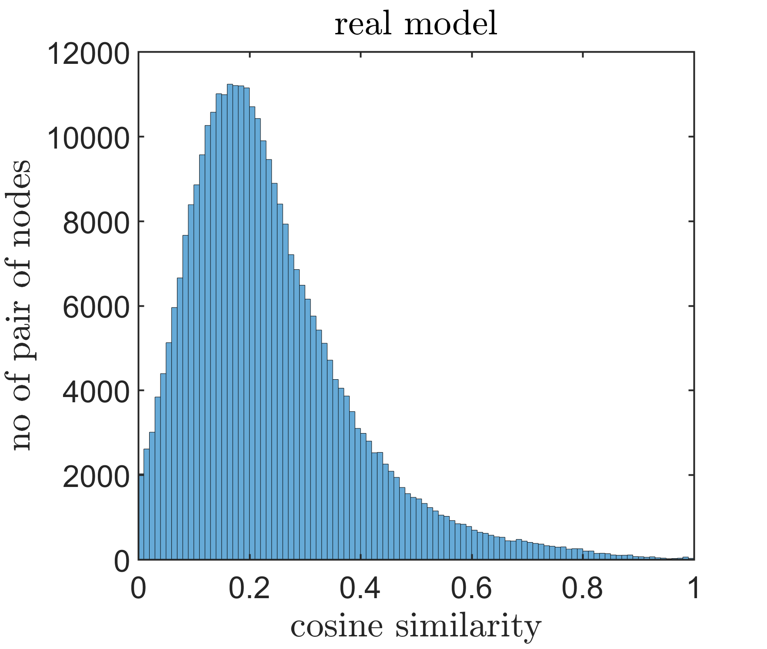
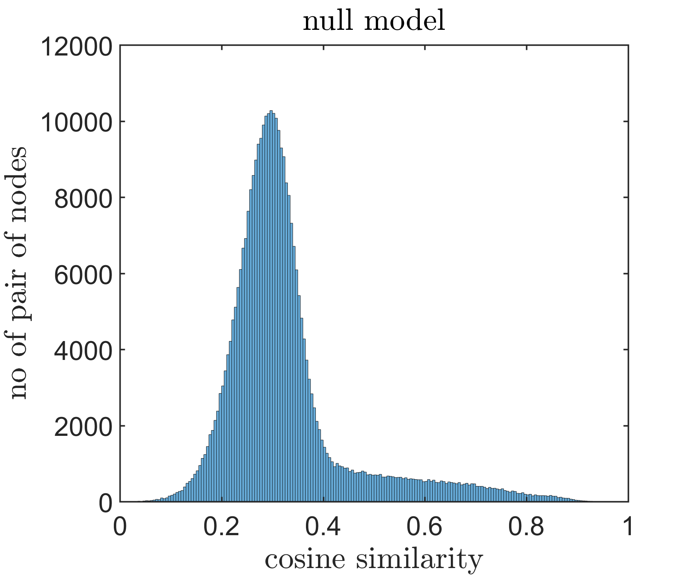

Comparing Distributions of Models
Let’s say we have two Histograms $(H^{A} and H^{B})$
Where $b$ is the number of bins
Notes:
To compare two models I rely on comparing the distance (chi-square) between two histograms.

Slide 38
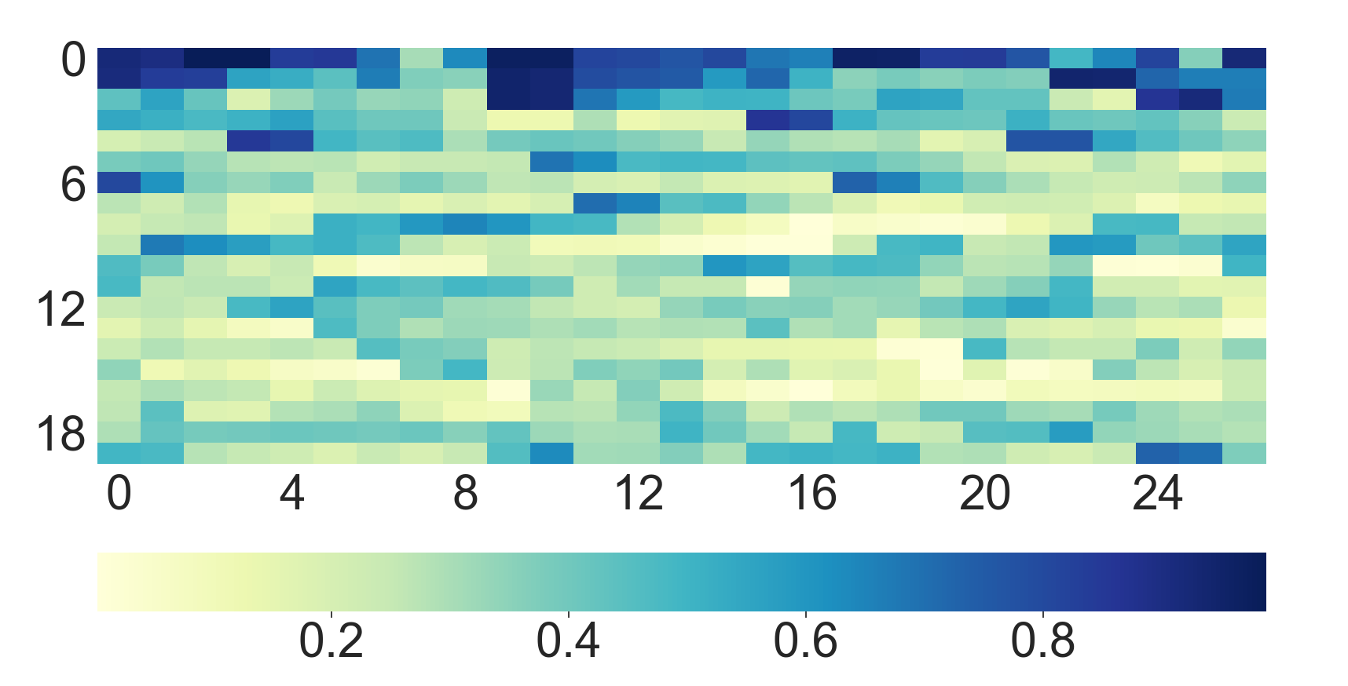
Exploratory Analysis of Models
A many-to-many visualization
One-to-many visualization
Notes:
- that can provide summary of how embedded vectors are organized in low-dimensional space
- based on heat maps that can illustrate the similarity of a single predefined node $u$ to all other nodes

Slide 39
Evaluation

Slide 40
Case Study I: New York City (NYC)
Notes:
- We perform the previously mentioned visual and quantitative analysis on these data-sets.

Slide 41
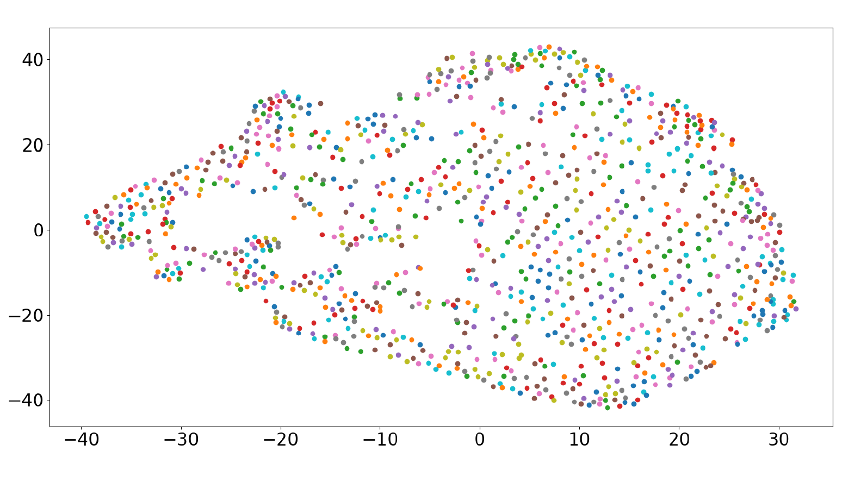
Exploratory Analysis: Many-to-Many
real
null
intermediate
Notes:
Learned vectors of each model are different
Real model nodes shows clustered nature, revealing that people do not move randomly, but rather follow specific patterns of semantic similarity
Null and intermediate model share structural similarity that can be attributed to random nature of the walks

Slide 42
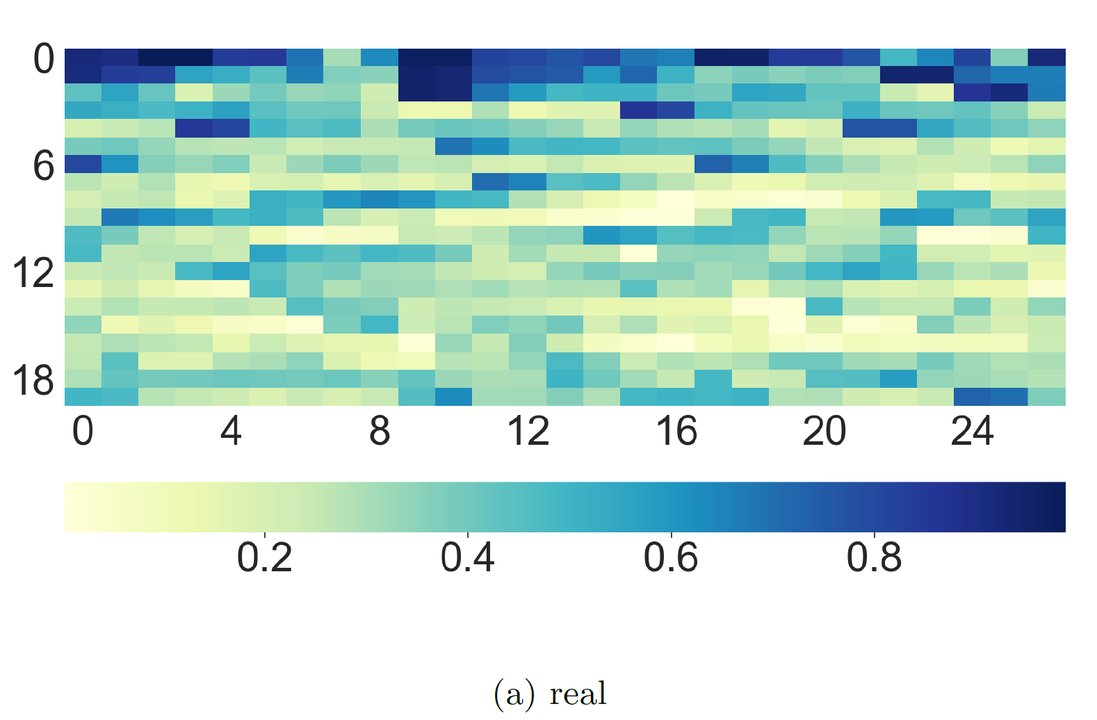
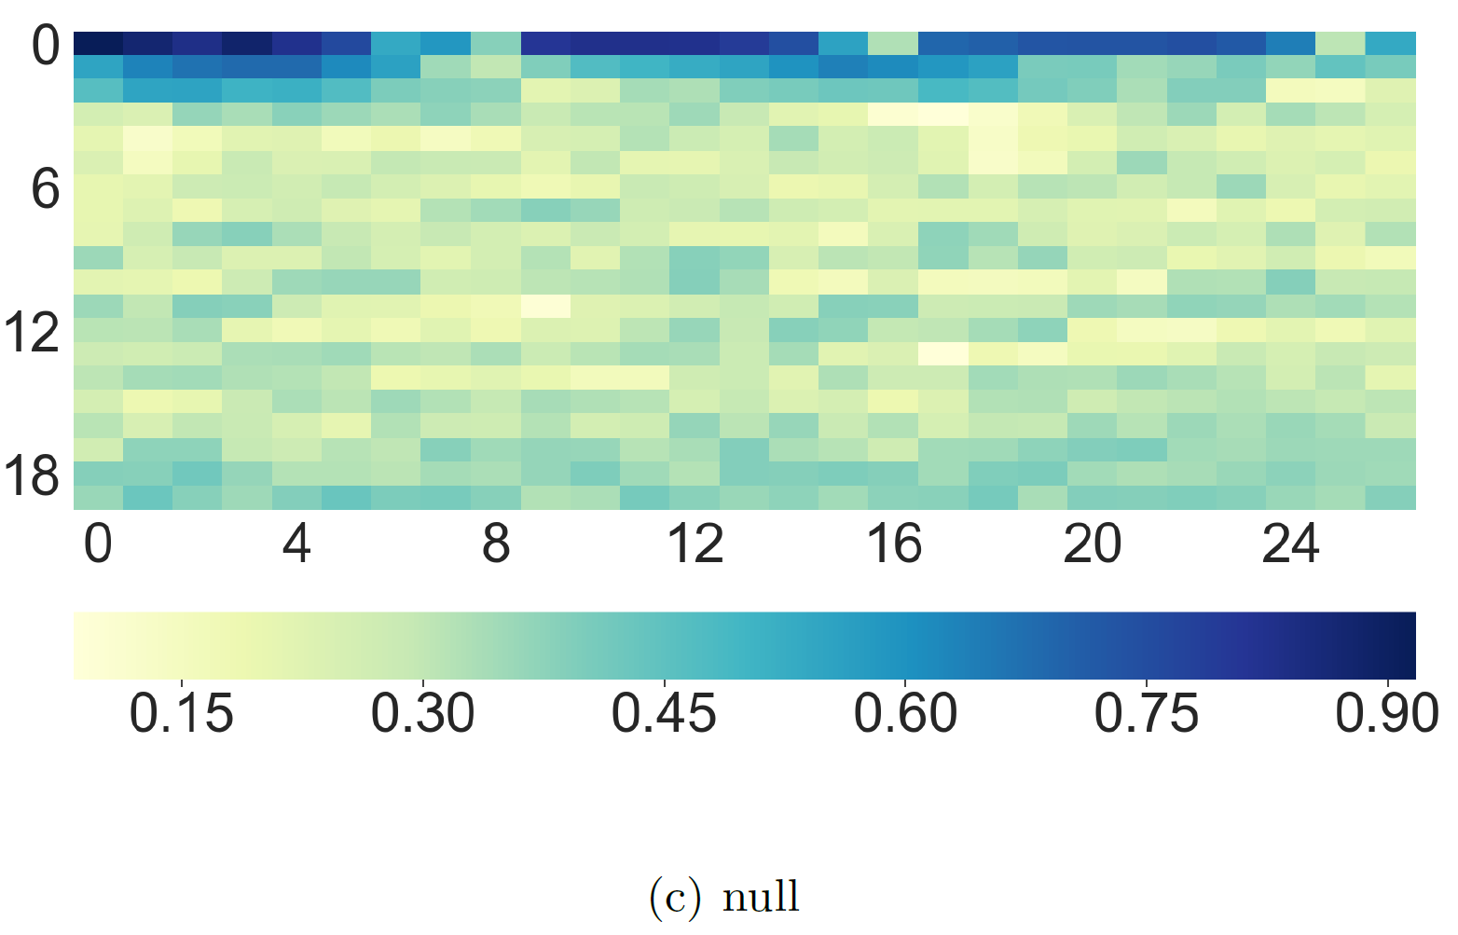
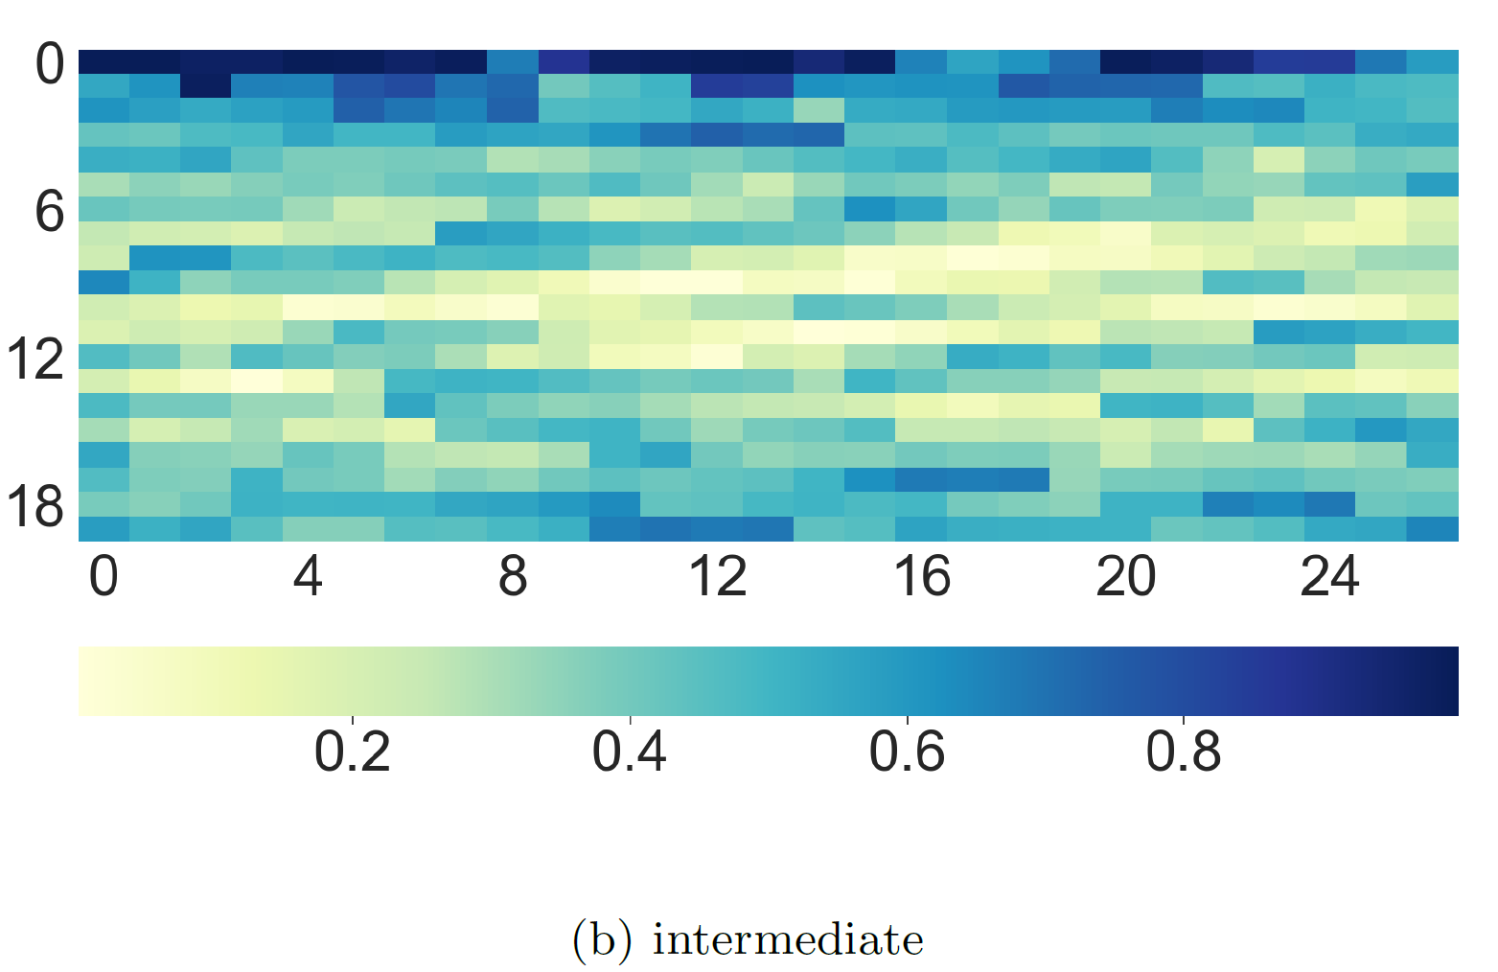
Exploratory Analysis: One-to-Many
real
null
intermediate
Notes:
Here we are showing similarity between a specific node and rest of the nodes in the geographical space.
Real model effectively reveals semantic similarity between geographical areas far apart.
Null model similarities are less stressed between areas far apart
Intermediate model is representing a middle situation (because of starting walk positions)

Slide 43
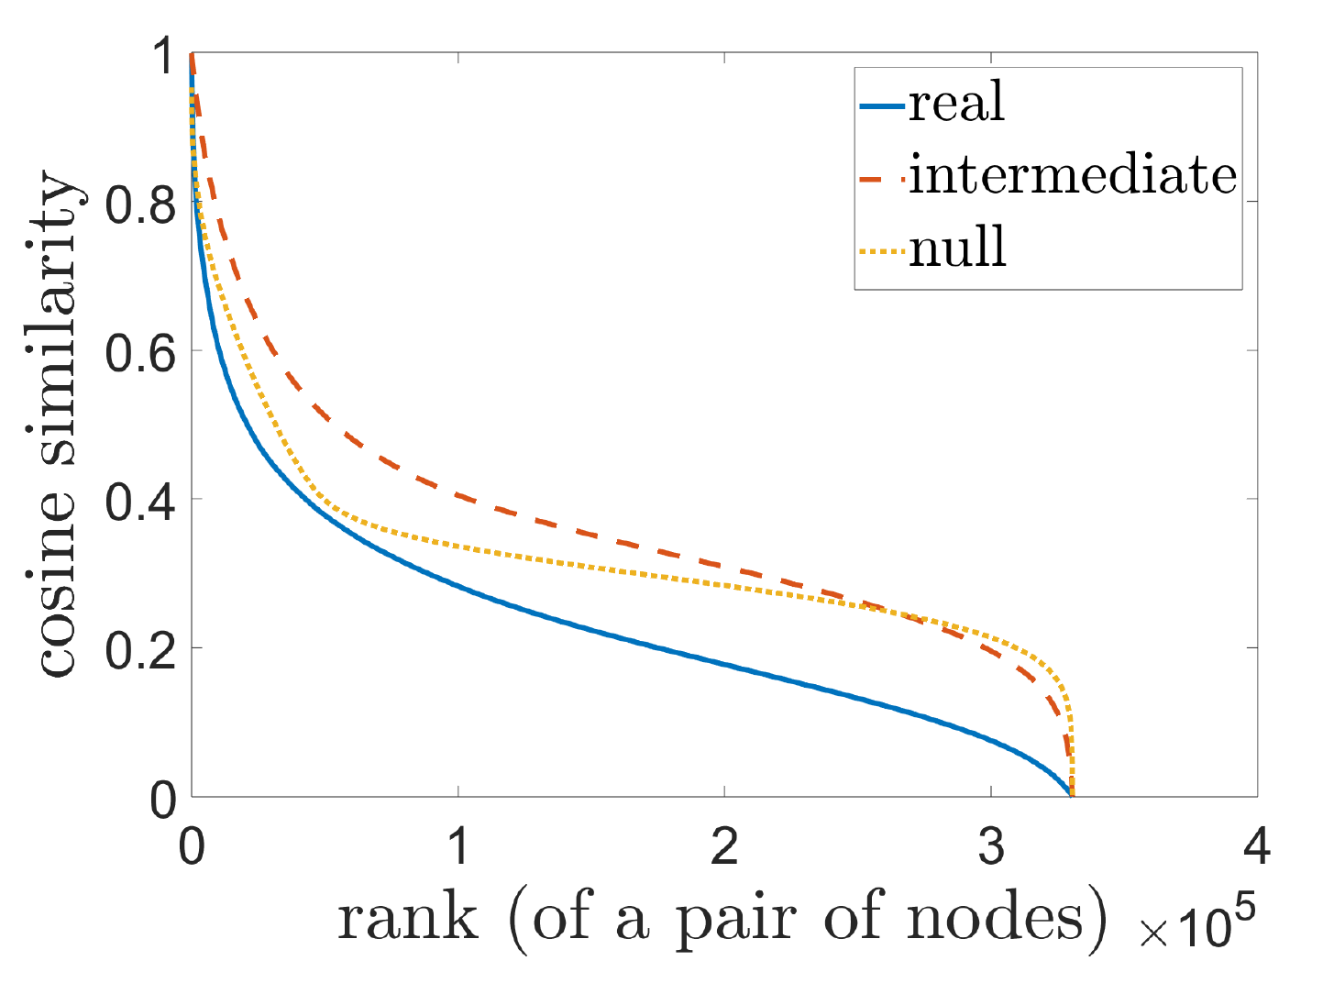
Quantitative: Cosine Similarity
Notes:
Real model is different than both null and intermediate model (consistent difference with intermediate due to same starting node)
Real model depicts consistently lower similarity at the same level of rank
Which indicates that similarity score is well-distributed in intermediate and null model due to randomness

Slide 44
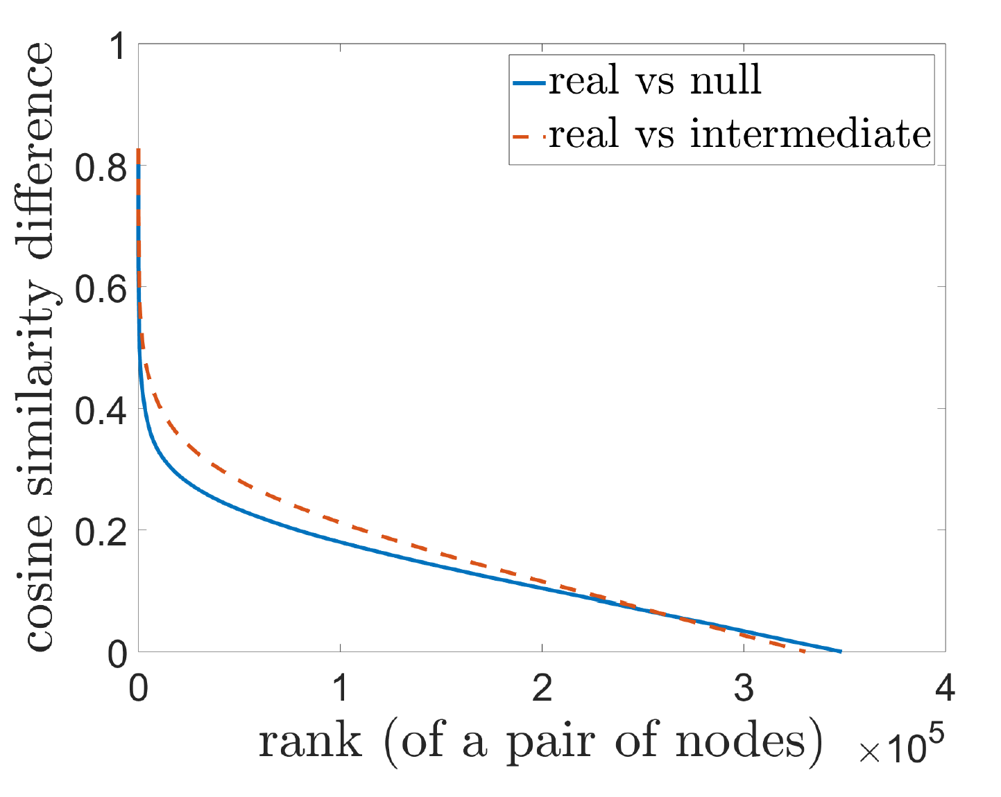
Quantitative: Interesting Pairs of Nodes
Notes:
For both cases, very few pairs of nodes depict very high difference, indicating semantic relationships of high “interestingness”
Behavior for both comparisons is same
Slight variation is based on null models creation

Slide 45
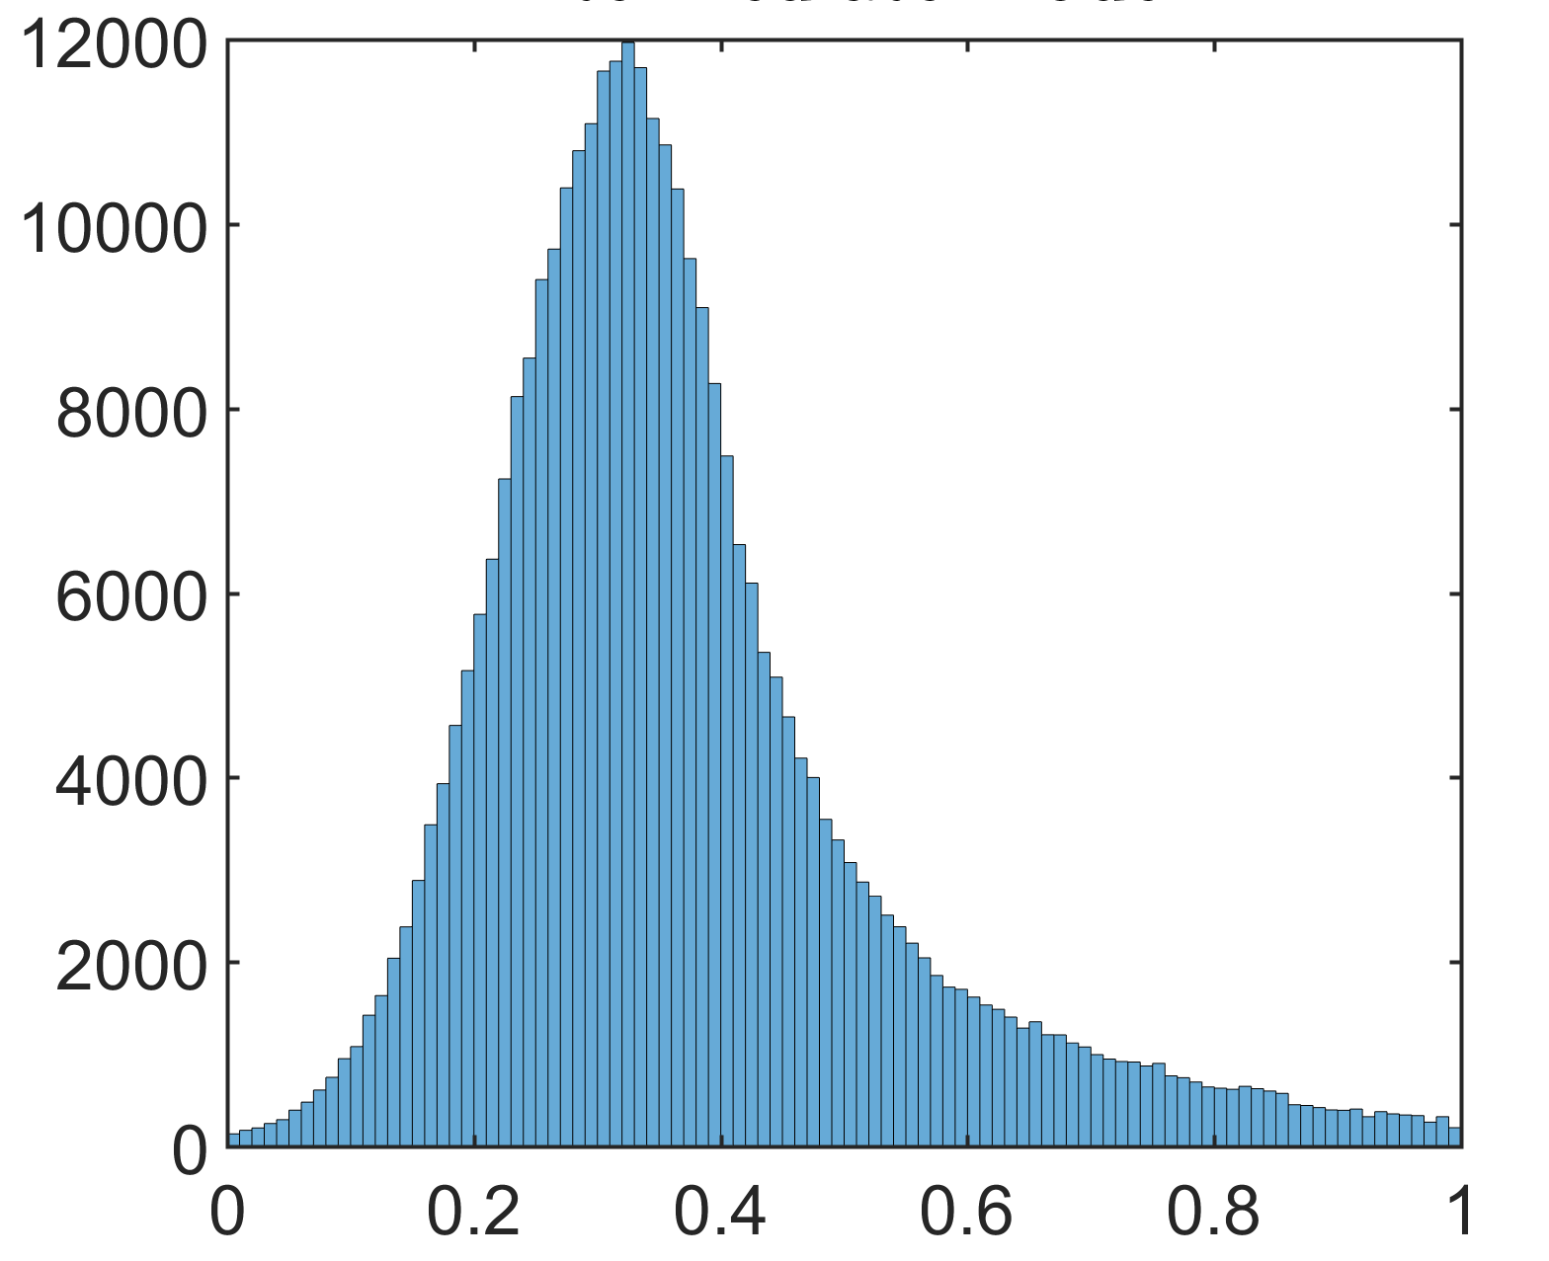
Distribution of Pair-wise Similarities
real
null
intermediate
no of pairs of nodes
cosine similarity
Notes:
Real model has a high concentration of smaller cosine similarity values (shifted on the left).
Real and intermediate model are well distributed
Null model has major chunk of values between 0.2 to 0.4 (How much different)

Slide 46
Case Study II: City of Porto

Slide 47
Exploratory Analysis: Many-to-Many
real
null
intermediate
Notes:
Learned vectors of each model are different
Null and intermediate model share structural similarity that can be attributed to random nature of the walks
Real model nodes shows clustered nature, revealing that people do not move randomly, but rather follow specific patterns of semantic similarity

Slide 48
Exploratory Analysis: One-to-Many
real
null
intermediate
Notes:
Here we are showing similarity between a specific node and rest of the nodes in the geographical space.
Real model effectively reveals semantic similarity between geographical areas far apart.
Null model similarities are less stressed between areas far apart
Intermediate model is representing a middle situation (because of starting walk positions)

Slide 49
Quantitative: Cosine Similarity
Notes:
Real model is different than both null and intermediate model (consistent difference with intermediate due to same starting node)
Real model depicts consistently lower similarity at the same level of rank
Which indicates that similarity score is well-distributed in intermediate and null model due to randomness

Slide 50
Quantitative: Interesting Pairs of Nodes
Notes:
For both cases, very few pairs of nodes depict very high difference, indicating semantic relationships of high “interestingness”
Behavior for both comparisons is same
Slight variation is based on null model creation

Slide 51
Distribution of Pair-wise Similarities
real
null
intermediate
no of pairs of nodes
cosine similarity
Notes:
Lastly we go back to our initial research question III

Slide 52
Research Question III
New York
City of Porto
How the behavior of people compare in different geographical space?

Slide 53
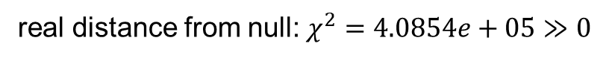

Chi-Square
City of New York
real distance from null: $χ^{2}=4.0854e+05≫0$
real distance from intermediate: $χ^{2}=3.0426e+05≫0$
City of Porto
real distance from null: $χ^{2}=6.1697e+05≫0$
real distance from intermediate: $χ^{2}=7.8492e+05≫0$
Notes:
Both in the case of NYC and City of Porto the real model is significantly different than both null and intermediate model, which means that the null hypothesis (that people in a city move randomly) can be rejected

Slide 54
Summary

Slide 55
Contribution and Summary
performed statistical analysis to distinguish geographical to semantic proximity
[IEEE Mobile Data Management 2020] “Learning Semantic Relationships of Geographical Areas based on Trajectories.” Saim Mehmood, Manos Papagelis.
Notes:
Trajectories can be used to understand latent semantic relationships between geographical areas and comprehend user perception regarding geographical space

Slide 56
References
[Proceedings of the 25th ACM SIGKDD, 2019] “Predicting dynamic embedding trajectory in temporal interaction networks,” S. Kumar, X. Zhang, and J. Leskovec, pp. 1269–1278.
[IEEE 5th International Conference on DSAA 2018] “Recommendation of Points-of-Interest Using Graph Embeddings”, G. Christoforidis, P. Kefalas, A. Papadopoulos, Y. Manolopoulos.
[Proceedings of the 23rd ACM SIGKDD 2017] “Planning bike lanes based on sharing-bikes’ trajectories,” J. Bao, T. He, S. Ruan, Y. Li, and Y. Zheng, pp. 1377–1386.
[25th ACM International on Conference on Information and Knowledge Management 2016] “Learning graph-based poi embedding for location-based recommendation,” M. Xie, H. Yin, H. Wang, F. Xu, W. Chen, and S. Wang, pp. 15–24.
[ACM Transactions on Intelligent Systems and Technology 2015] “Trajectory data mining: an overview,” Y. Zheng, vol. 6, no. 3, p. 29, 2015.

Slide 57
Thank you!

